Slide 1

Techno International New Town
(Formerly Known As Techno India College Of Technology)
Department Of Computer Science & Technology
Project Tile:
Data Analytics On Diabetics Prediction
Team: Coding Monkeys
Members:
Rajarshi Baral
Arpita Saha
Sangeeta Barua
Aoyan Mondal
Under The Guidance Of
Prof. Mr. Swarup Chakraborty
----------------------------------------------

Slide 2
INTRODUCTION
Diabetes is one of the most common chronic diseases affecting millions of people worldwide. It occurs when the body cannot effectively control blood sugar levels, which can lead to serious health complications if not detected and managed early. Early detection of diabetes can help individuals take preventive measures, receive timely treatment, and improve their quality of life.
With the rapid development of technology, machine learning (ML) has become a powerful tool in the healthcare sector. By analyzing historical medical data, ML algorithms can learn patterns and predict future outcomes with high accuracy. In the context of diabetes, these algorithms can help identify individuals at risk based on various characteristics such as age, BMI, blood pressure, insulin levels, and more . This project focuses on building a machine learning model that can accurately predict the likelihood of an individual developing diabetes.

Slide 3
PROBLEM DEFINATION
Feature | Description
Pregnancies | Number of times woman has been pregnant
Glucose | Plasma glucose concentration
Blood Pressure | Diastolic blood pressure(mm Hg)
Skin Thickness | Triceps skinfold thickness(mm)
Insulin | 2-Hour serum insulin(mu U/ml)
BMI | Body Mass Index(weight in kg/(height in m)^2)
Objective - Gestational diabetes is a condition in which women without previously diagnosed diabetes exhibit high blood glucose levels during pregnancy. Early diagnosis is essential to manage health risks for both mother and child. Machine learning can help predict the likelihood of diabetes based on measurable health parameters.
Pre-existing Type 1 Diabetes: Autoimmune condition where the body does not produce insulin. It is present before pregnancy.
Pre-existing Type 2 Diabetes: A condition where the body becomes resistant to insulin or doesn't produce enough insulin. It is usually related to lifestyle and may be present before pregnancy.
Diabetes Pedigree Function | A function that scores likelihood of diabetes based on family history
Outcomes | Class label: 0= no diabetes, 1 =diabetes

Slide 4
PROBLEM DEFINATION
How is the difference from others models/problems?
Aspect | This model | Typical Differences
Domain | Medical/Clinical | Other ML problems could be in finance, marketing , etc..
Data Type | Mostly Numeric | Some other models might include more categorical and text data
Feature Importance | All features are medically relevant | In generic ML tasks, feature relevant may not be so direct
Outcome Impact | High-stakes(medical) | Business models may be less critical in terms of error consequences.

Slide 5
PROBLEM DEFINATION
How to Solve It
Handle missing or zero values (especially in Glucose, Blood Pressure, BMI, etc.)
Normalize or standardize features
(especially when using algorithms like KNN, SVM)
Split into Train/Test sets
Data Pre-processing:
Visualize correlations
Analyze feature distributions
Understand class imbalance
Exploratory Data Analysis (EDA):

Slide 6
PROBLEM DEFINATION
Model Selection:
Feature Selection :
Logistic Regression
Support Vector Machines (SVM)
Decision Trees / Random Forest
Use techniques like Recursive Feature Elimination, PCA, or correlation analysis

Slide 7
PROBLEM DEFINATION
Evaluation Metrics:
Accuracy
Classification Report (Precision, Recall, F1-Score)
ROC-AUC Curve
Expected Output:
A model that predicts the likelihood of gestational diabetes.
A report on the most significant predictors .
Visualization dashboards showing patterns, trends, and at-risk groups.

Slide 8
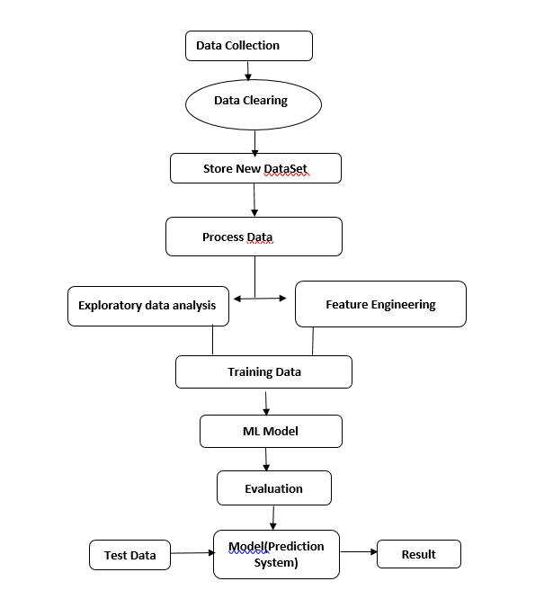
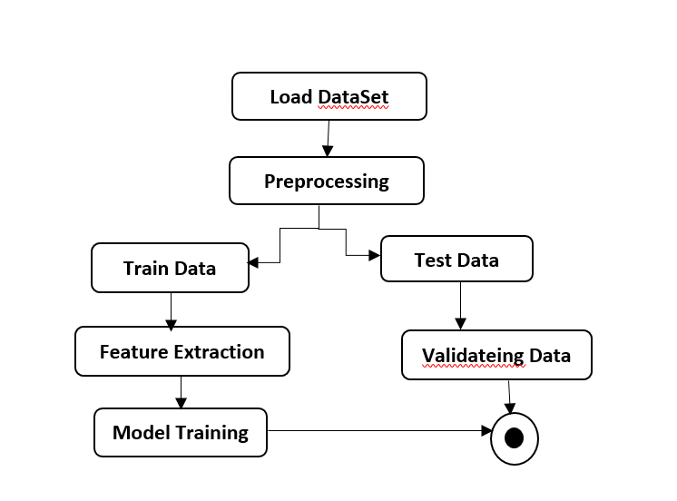
POGRESS
Flow chart
DIAGRAMS
State diagram

Slide 9
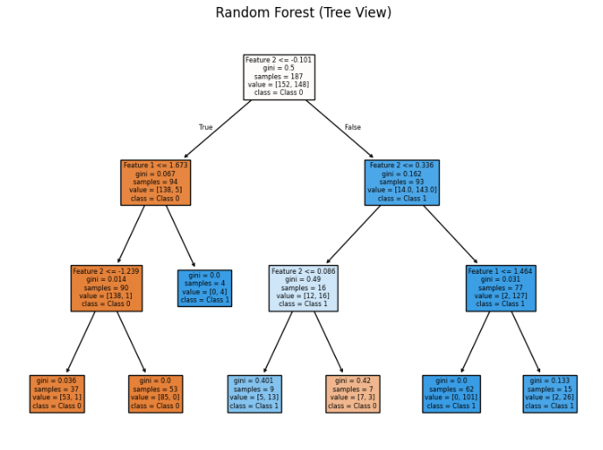
PROGRESS
A Random Forest is a collection of many Decision Trees trained on different parts of the dataset. It combines their results for a more accurate and stable prediction.

Slide 10
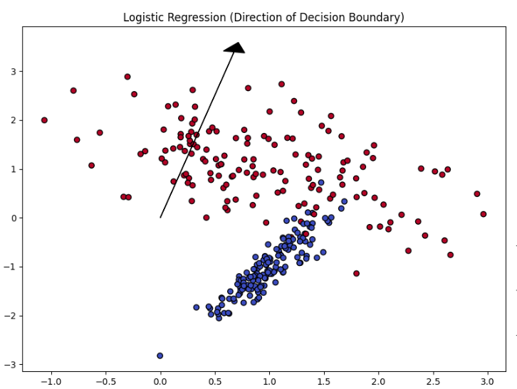
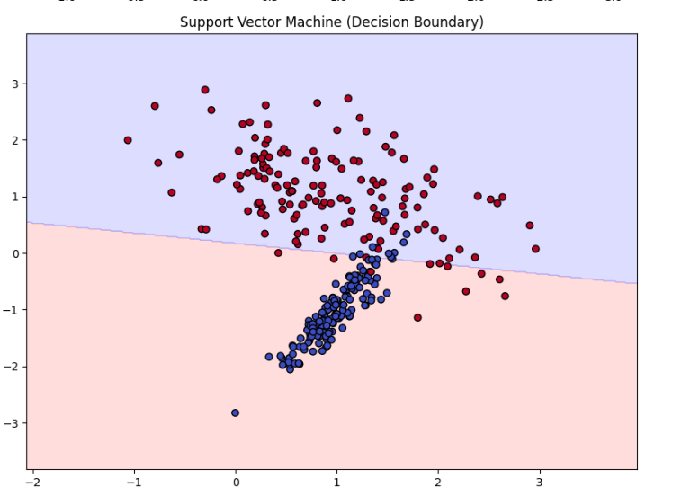
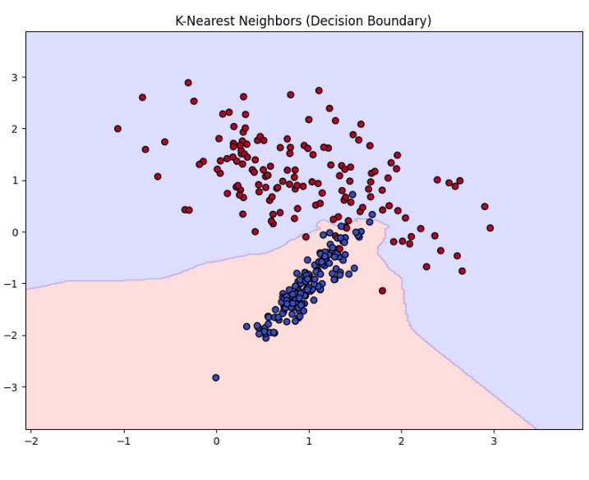
PROGRESS
Handles Imbalance
Robust to overfitting
Versatile with kernels
Logistic Regression
Support Vector Machine
Binary Prediction
Understand which features impact the result
Quick train and test
Effective with normalized numeric features
Easy to understand
Sensitive to local patterns
K-Nearest Neighbors

Slide 11
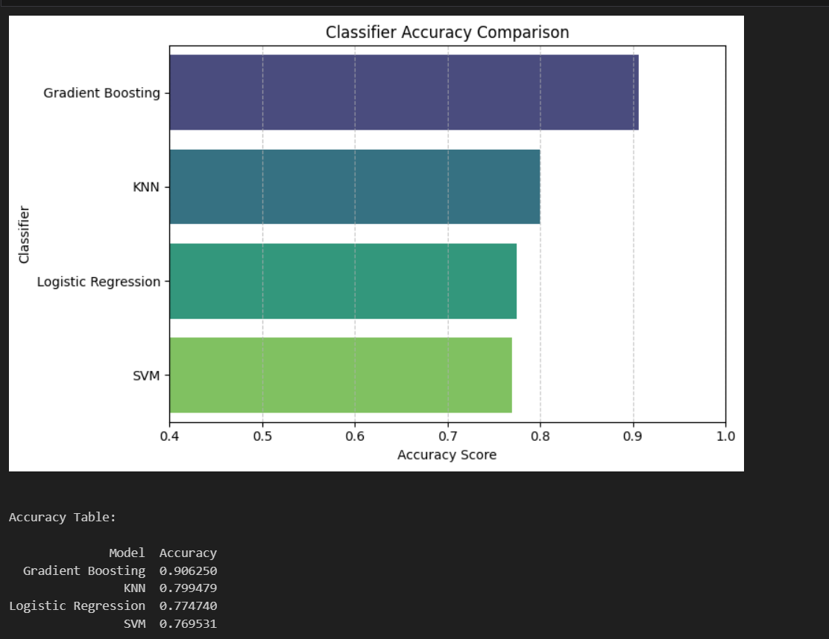
PROGESS
Classifier Comparison

Slide 12
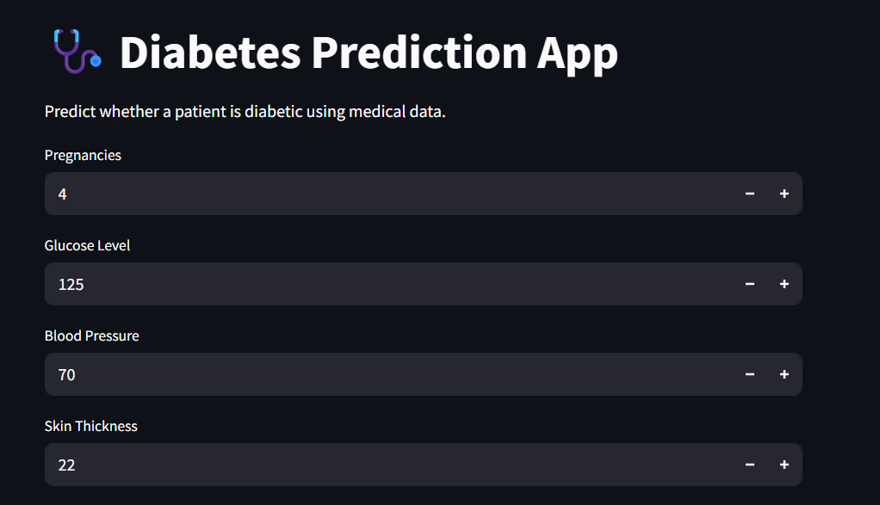
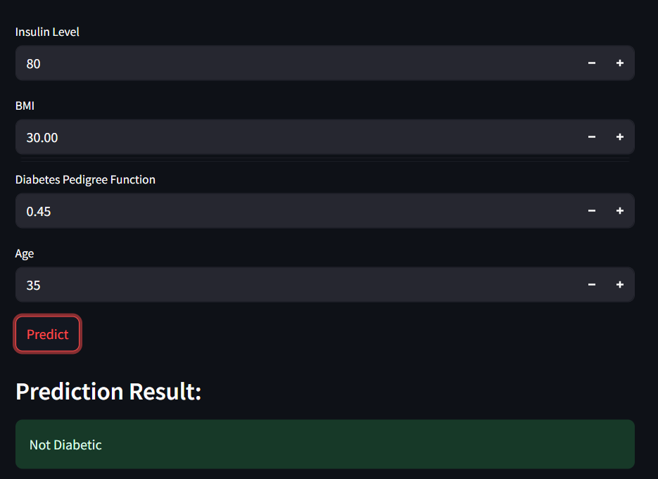
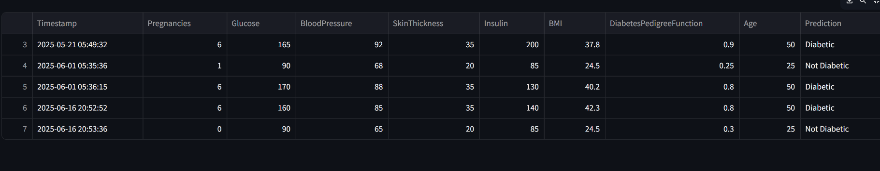
RESULTS

Slide 13
FUTURE SCOPE
Advanced Predictive Analytics
Personalized Healthcare
Integration with Health Information Systems
Genomics and Biomarker Analytics
AI-Powered Decision Support Systems

Slide 14
CONCLUTION
Our Data Analytics on Diabetes Prediction project demonstrates the effectiveness of machine learning in identifying diabetes risk based on key health indicators. By preprocessing data, selecting relevant features, and applying predictive models, we achieve insightful results that can assist in early diagnosis and intervention. The correlation analysis helps understand relationships between variables, enhancing model interpretability. With further improvements in data quality and model optimization, this approach can significantly contribute to healthcare decision-making, promoting proactive diabetes management and awareness.

Slide 15
BIBLIOGRAPHY:
THANK YOU
[1] Sarwar, Muhammad Azeem, et al. "Prediction of diabetes using machine learning algorithms in healthcare." 2018 24th international conference on automation and computing (ICAC). IEEE, 2018.
[2] Mujumdar, Aishwarya, and Vb Vaidehi. "Diabetes prediction using machine learning algorithms." Procedia Computer Science 165 (2019): 292-299.
[3] Kumar, P. S., & Pranavi, S. (2017, December). Performance analysis of machine learning algorithms on diabetes dataset using big data analytics. In 2017 international conference on infocom technologies and unmanned systems (trends and future directions)(ICTUS) (pp. 508-513). IEEE.
[4] Hassan, Md Mehedi, et al. "Early predictive analytics in healthcare for diabetes prediction using machine learning approach." 2021 12th International Conference on Computing Communication and Networking Technologies (ICCCNT). IEEE, 2021.
[5] Kalyankar, Gauri D., Shivananda R. Poojara, and Nagaraj V. Dharwadkar. "Predictive analysis of diabetic patient data using machine learning and Hadoop." 2017 international conference on I-SMAC (IoT in social, mobile, analytics and cloud)(I-SMAC). IEEE, 2017.
[6] Nibareke, Thérence, and Jalal Laassiri. "Using Big Data-machine learning models for diabetes prediction and flight delays analytics." Journal of Big Data 7.1 (2020): 78.

Slide 16
THANK YOU
[1] Sarwar, Muhammad Azeem, et al. "Prediction of diabetes using machine learning algorithms in healthcare." 2018 24th international conference on automation and computing (ICAC). IEEE, 2018.
[2] Mujumdar, Aishwarya, and Vb Vaidehi. "Diabetes prediction using machine learning algorithms." Procedia Computer Science 165 (2019): 292-299.
[3] Kumar, P. S., & Pranavi, S. (2017, December). Performance analysis of machine learning algorithms on diabetes dataset using big data analytics. In 2017 international conference on infocom technologies and unmanned systems (trends and future directions)(ICTUS) (pp. 508-513). IEEE.
[4] Hassan, Md Mehedi, et al. "Early predictive analytics in healthcare for diabetes prediction using machine learning approach." 2021 12th International Conference on Computing Communication and Networking Technologies (ICCCNT). IEEE, 2021.
[5] Kalyankar, Gauri D., Shivananda R. Poojara, and Nagaraj V. Dharwadkar. "Predictive analysis of diabetic patient data using machine learning and Hadoop." 2017 international conference on I-SMAC (IoT in social, mobile, analytics and cloud)(I-SMAC). IEEE, 2017.
[6] Nibareke, Thérence, and Jalal Laassiri. "Using Big Data-machine learning models for diabetes prediction and flight delays analytics." Journal of Big Data 7.1 (2020): 78.

